Slide 1
Monitor, Serializer, Path Expression

Slide 2
High Level synchronization Mechanisms
Synchronization mechanisms discussed so far are primitive to build large complex reliable systems.
The need for reliable and easily manageable software for complex systems has to be addressed.
To achieve the same high level concepts are integrated into the programming languages which is independent of hardware implementation.
Some of the high level mechanisms are: Monitors, Serializers and path expressions
Notes:
using semaphores incorrectly can result in timing errors that are difficult to detect, since these errors happen only if particular execution
sequences take place and these sequences do not always occur.

Slide 3
MONITORS
Monitors are abstract data types for defining shared objects and for scheduling access to these objects.
A monitor consist of procedures, shared object and administrative data.
Procedures provides access to shared resources and are called by processes needing access to resources.

Slide 4
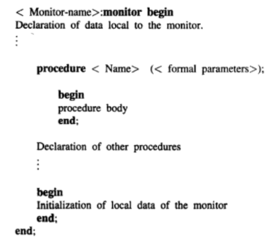
Structure of a procedure

Slide 5
Monitor
Execution of a monitor obeys the following constraints:
Only one process can be active within the monitor at any time and other processes trying to access the monitor are placed in the monitor’s entry queue.
Procedures of a monitor can access data only local to the monitor and cannot access an outside variable
The variables or data local to the monitor cannot be directly accessed from outside the monitor.

Slide 6
Monitor
Monitor accomplish synchronization through two special operations: wait and signal, executed within monitor’s procedure.
There are conditional variables that corresponds to the various conditions to block and unblock processes.
Wait and signal operations are specified in association with a condition variable.
condition_variable.wait
Wait operation suspends the caller process and the caller process releases the monitor

Slide 7
Monitor
The suspended process is placed in the queue of corresponding condition variable.
There is an entry queue containing process that are trying to enter the monitor for first time.
Executing the signal operation causes one of the waiting process to regain the control of monitor.
The processes in the queues of condition variable will be chosen over entry queue for the access to monitor.
The waiting process that took over the control of monitor starts executing statements that follows the wait statement.

Slide 8
Monitor
Main advantage is the flexibility in scheduling the processes in waiting queues.
First-in-first out approach is used for waiting processes.
Priorities can also be associated with processes in queues

Slide 9
Solution to R-W Problem using Monitor
4 Procedures are used:
startread- called by reader for accessing the file
endread: -called when read is finished
startwrite: called by writer before writing to file
endwrite: after write is finished
boolean value busy :whether writer is active
readercount -no:of active readers

Slide 10
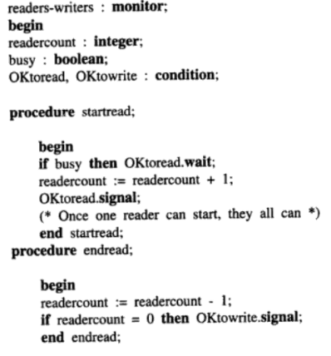
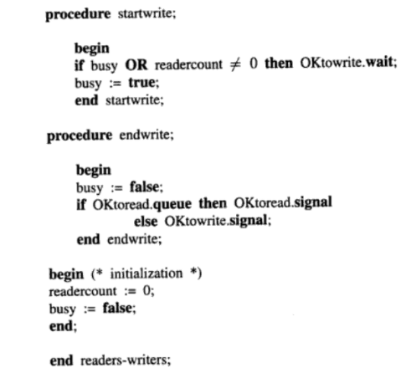

Slide 11
Procedure: startread
If an active writer is present, the reader process which invokes the procedure is blocked and kept in the queue of Okread.
If no process is performing write operation, the reader process increments readercount and activates a waiting reader, if present.
The waiting reader process gains the control of the monitor and can start executing startread procedure for accessing the file
Mean while, the 1st reader process can proceed with reading the file.

Slide 12
Procedure: endread
This procedure is invoked by each reader process, on completion of file access.
The readcount is decremented.
When there are no active readers(readcount=0),the last exiting reader executes oktowrite.signal, activating any waiting writer

Slide 13
Procedure: startwrite
A process invoking startwite proceeds only if there are no active readers or writers
The variable busy is set to true by writer process to indicate that a write is active

Slide 14
Procedure: endwrite
Invoked by writer process on completion of file access.
Set busy=false indicating that no writer is active.
Checks for any waiting readers in Oktoread Queue and signals it
Otherwise signals waiting writers in Oktowrite queue.
If there are more than one waiting readers, they are activated and enters monitor one by one.
Meanwhile the processes trying to enter monitor for the first time are blocked and kept in entry queue

Slide 15
Monitor: Drawbacks
Absence of Concurrency: Only one Process can be active within the monitor.
Procedures of monitor should be invoked before and after accessing the shared resources
But this may result in processes improperly accessing resources without first invoking monitor’s procedure.
There is a possibility of deadlock in case of nested monitor calls

Slide 16
Serializer

Slide 17
Serializer
Introduced to overcome some of the drawbacks of monitor
Serializer allows concurrency inside and so shared resource can be encapsulated inside in a serializer.
Serializer replaces explicit signalling required in monitor with automatic signalling.
This is achieved by specifying the condition on which waiting process can resume execution

Slide 18
Serializer
Similar to monitors, serializer is also an abstract data type defined by a set of procedures(operations) that encapsulates shared objects.
Users access resources through the operations of serializer
Only one process have access to serializer at a time.
However, Procedures of serializer may have hollow regions where in multiple processes can be concurrently active.
When a process enters hollow region ,it releases the possession of serializer and some other process may intrun take possession of serializer.

Slide 19
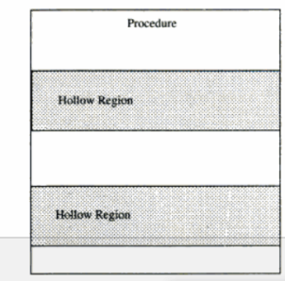
Structure of a procedure

Slide 20
Serializer
Concurrency is achieved in the hallow regions of a serializer.
In a hollow region the process just releases the serializer and the process can regain control when it gets out of the hollow region.

Slide 21
Serializer
Any no: of processes can be active inside hollow region
Hollow region is specified by join-crowd operation which allows processes to release serializer (not exit) and access resources, achieving concurrency.
join-crowd(<crowd>)then <body> end
On execution of join-crowd operation, possession of the serializer is released, identity of the process invoking the join-crowd is recorded in the crowd and list of statements in the body is executed.
At the end of execution of the body , leave-crowd operation is executed which results in:
Process regain the possession of the serializer
Identity of process is removed from crowd

Slide 22
Serializer : QUEUE
A serializer has queue variables
An enqueue operation along with the condition the process is waiting for provides delay or blocking facility.
enqueue(<priority>,<queue-name>) until (<condition>)
A process invoking enqueue is placed at an appropriate position in queue and the condition is not checked until the process reaches the head of the queue.
The serializer automatically restarts the process at the head, whose condition is satisfied and no other process has control of serializer currently.

Slide 23
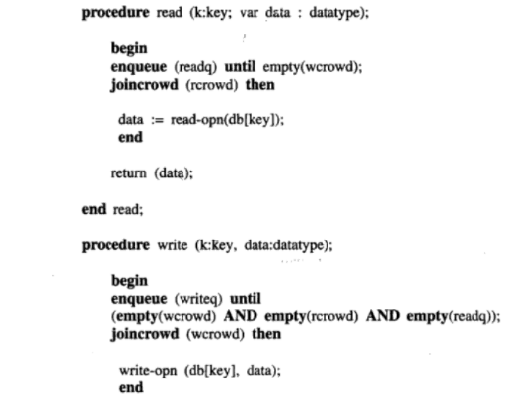

Slide 24
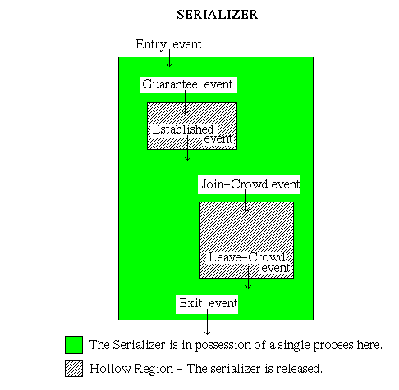
Serializer Events
Serialized doesn’t need explicit signalling when compared to monitor
Serializer derives its name from the fact that all events that gain or release possession of serilaizer are totally ordered in time

Slide 25
Serializer Events
Every operation in a serializer can be identified as an event.
An Entry event can be a request for serializer, in which a condition will be checked. ( For eg., Is the serializer free for the process to enter ? )
If the condition is true the process gains control of the serializer.
Then before the process accesses the resource, a guarantee event is executed.

Slide 26
Serializer Events
The guarantee event results in an established event if the condition is true, else the process releases the control of the serializer and waits in its queue.
When a resource is available, the process enters (Join-Crowd event) the Crowd and accesses the Resource.
After completing the job with the resource, the process leaves (Leave-Crowd event) the crowd and regains control of the serializer ( if the serializer is available, else it has to wait).

Slide 27
Path Expression
A different approach to process synchronization
It restricts the set of admissible execution histories of operations on shared resources.
It ensures that no incorrect state is ever reached and it indicates the order in which operations on a shared resource can be interleaved.
The format for path expression is:
path S end
Where S denotes possible execution histories
path S end

Slide 28
Path Expression
It is an expression whose variables are operations on the resources and whose operators are:
Sequencing( ; ) -Defines a sequencing order among operations.
Eg: path open; read; close; end
means an open must be performed first, followed by a read and close in that order.
There is no concurrency in the execution of these operations

Slide 29
Path Expression
Selection( + ): It signifies, only one of the operations connected by a + operator can be executed at a time
Eg: path read + write end
Here only read or write can be executed at a time, but the order of execution of these operations doesn’t matter .

Slide 30
Path Expression
Concurrency( { } ): any no:of operations delimited by { } can be executed at a time.
Eg :path {read} end
Here any no: of read operations can be performed concurrently
The path expression for reader-writer problem for weak reader’s priority is given as:
path {read}+write end

